Slide 1
Excitement of engineering
Austin Flickinger

Slide 2
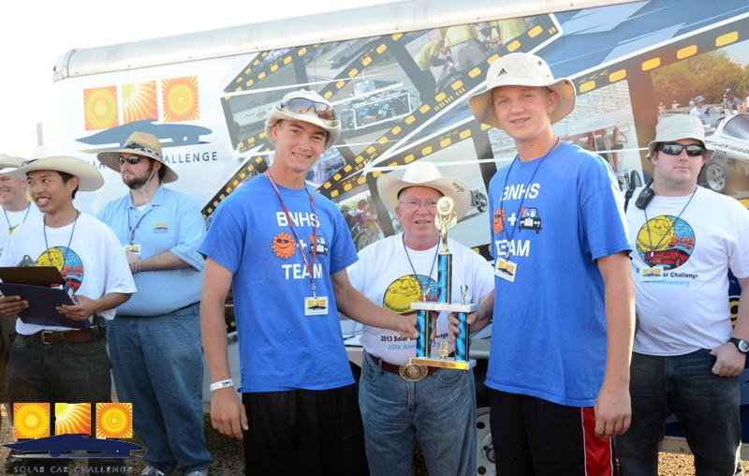
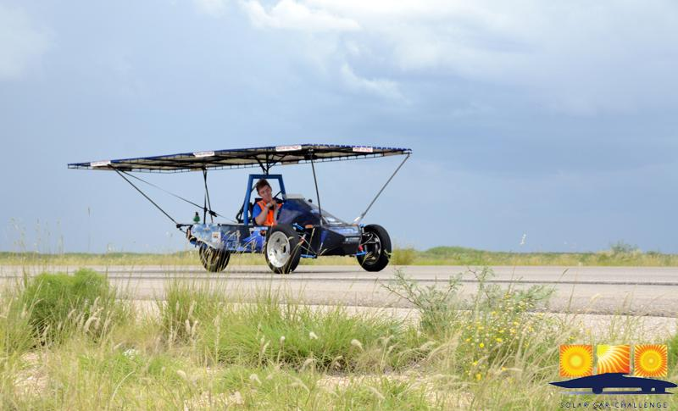
Solar CAR Background
Byron Nelson Solar Car Team Co-Captain (2010-2013)
2010 Cross Country Race to Boulder, CO
2011-2012 Track Race at Texas Motor Speedway
2013 Cross Country Race to Los Angeles, CA

Slide 3
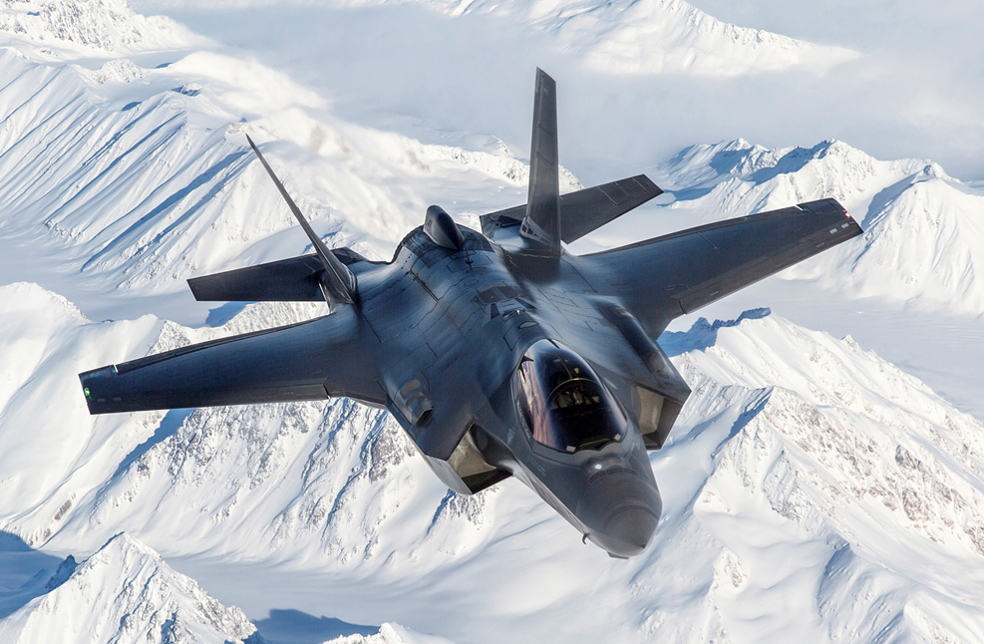
Professional Background
Texas A&M University (2013-2018)
Bachelors in Industrial Engineering
Southern Methodist University (2019-2022)
Masters in Engineering Management
Engineer at Lockheed Martin Aeronautics
Fort Worth, TX (2018-Present)

Slide 4
Exciting things in engineering
Solving challenging problems and finding creative solutions
Continuously learning new technologies and industry trends
Collaborating with other skilled and knowledgeable engineers
Seeing the direct impact of your work on the company's success
Opportunities for career advancement and professional development
Creating new and innovative products or services
The satisfaction of seeing your work come to life and being used by customers

Slide 5
Things I have learned
Be curious, ask questions and stay observant
Don’t be afraid to fail, it’s completely normal and how you learn best
Surround yourself with like minded people that can help guide and push you towards success
Goal setting
Where do you want to be in 5-10 years?
What are you doing now to help prepare you for that?

Slide 6
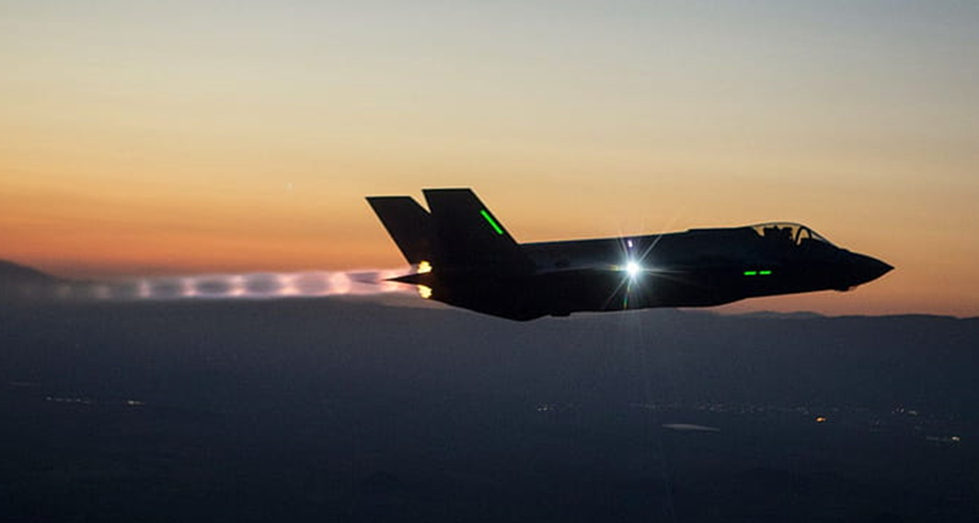
Thank You
CONTACT INFO:
aflick19@gmail.com
817-201-9769

